Slide 1



MUSIC RECOMMENDATION SYSTEM
PROJECT
Presented by:
Melody Minds
Ankit Raj - E22CSEU0331
Ishang Kansal - E22CSEU320
Nikhil - E22CSEU0326
AryanMukund Singh - E22CSEU0321

Slide 2
Abstract
Song recommendation systems are like your music companion, suggesting songs tailored to your tastes, much like a knowledgeable friend.
These systems use advanced tech to understand your music preferences by checking what you've listened to and predicting what you might want to hear next.
They work by collecting your music data and using patterns and numbers to figure out what you'd like, making the experience more personal.
Apart from music apps, they're used in radios and custom playlists, making your music journey more special.
The best part is they keep getting better, continuously learning to refine their suggestions and offering even more awesome song recommendations based on your preferences.

Slide 3




Introduction
Introduction:
Amidst a plethora of music selections, pinpointing preferred content presents a substantial challenge.
Song recommendation systems embody algorithmic frameworks that systematically assess user preferences, akin to a recommendation agent, streamlining music content discovery aligned with individual tastes.
Importance of Music Recommendation:
These systems not only enhance user engagement within music platforms but also serve as a critical promotional tool for artists, extending their reach to a wider audience.

Slide 4


Presentation Overview:
This session will scrutinize the intricate operational mechanisms, practical applications, and complex obstacles encountered by these systems.
Audience Engagement:
Queries and clarifications are encouraged. By the conclusion, a comprehensive understanding of how these technological advancements shape music consumption and personalization will be attained.

Slide 5

Methods
In This Project we used two types of Recommendation methods -
Popularity-driven Recommender
Technology
Item Recommender System Based on Item Similarity

Slide 6
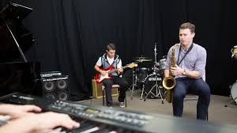
Popularity-driven Recommender
Technology :
Certainly! This method of recommending songs is like making a list of the most well-liked songs by everyone. It looks at how many times each song has been listened to by all users. Then, it makes a top 10 list of the songs that are most popular, meaning they're listened to the most by everyone. When a user asks for recommendations, it gives them this list of the top 10 songs, no matter what that particular user might like. It's like suggesting the most famous or commonly enjoyed songs, without considering what an individual person might prefer.

Slide 7

Item Recommender System Based on Item
Similarity :
This system recommends songs by comparing how often different songs are listened to together. It creates a kind of map showing which songs tend to be enjoyed by the same people. When a user asks for suggestions, it looks at the songs they already like and finds similar ones based on this "map." It gives the user a list of the top ten songs that are most like the ones they already enjoy. If it can't find similar songs, it says it can't make recommendations by returning -1. There's also a function that helps find similar songs to a given list of songs using this method.

Slide 8
RESULT
Assessing music recommendation systems involves checking if the suggested songs match a user's taste (precision) and if all the songs a user might like are suggested (recall). Understanding user satisfaction often involves asking users directly for feedback. Great music recommendation systems go beyond suggesting popular tunes—they aim to truly understand each user's preferences, introducing them to new music they'll genuinely enjoy. These systems enhance a user's music experience by making it more personalized and enjoyable, fostering music discovery and connections within the music community.

Slide 9
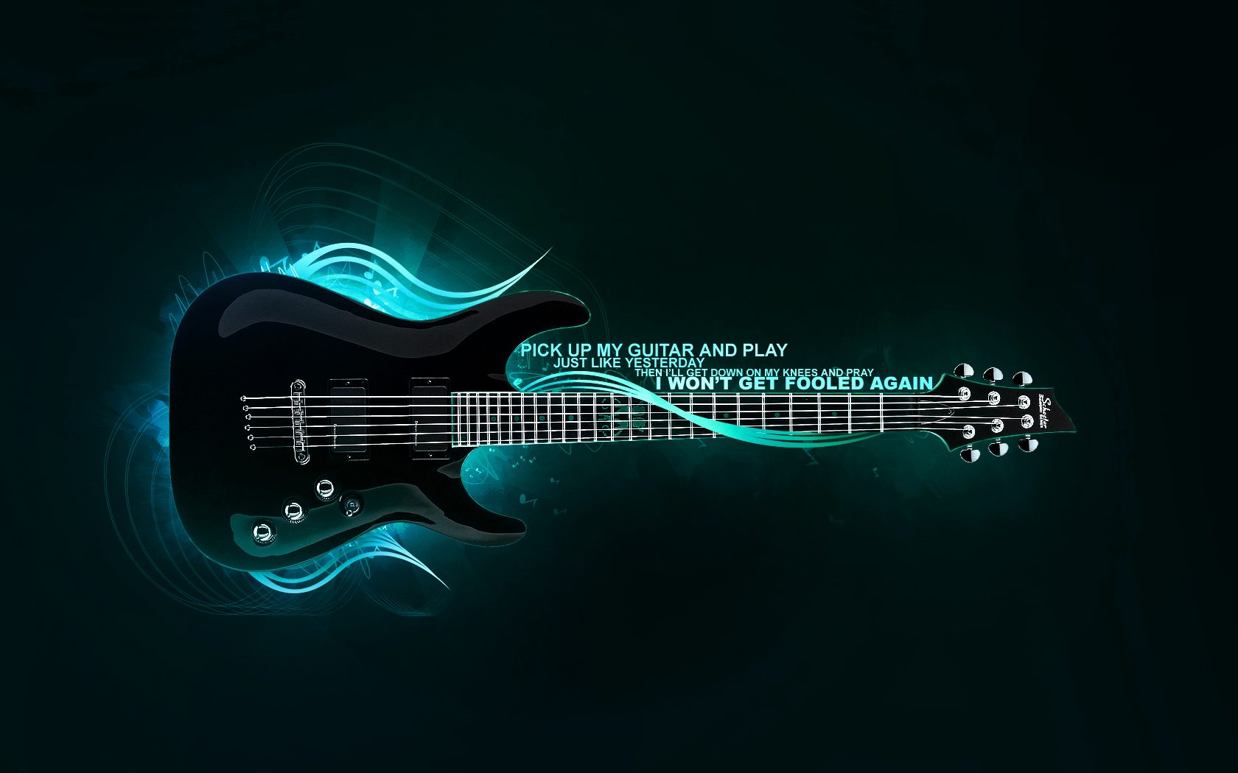
Conclusion
This system will enhance the user experience with digital music players.
This system provides personalized suggestions that cater to individual tastes and preferences.
User will be able to expand musical landscape and discover new music that resonates with them.

Slide 10
THANK YOU

